Slide 1


Presentation on Proactive Road Safety: A Hybrid Machine Learning Model for Predicting Traffic Accidents and Severity
Guided By: Presented By:
Prof. Pawan Makhija Ananya Panwar(0827CD221010)
https://github.com/Ananya2517
Bhoomika Sharma(0827CD221021)
https://github.com/Bhoomika71
Devanshi Joshi(0827CD221027)
https://github.com/Ddevanshii10
Hemanshi Adlak(0827CD221036) https://github.com/Hemanshi-Adlak

Slide 2
Contents
Introduction
1.1 Overview
1.2 Purpose
Requirement Engineering
2.1 Requirement Collection
2.2 Functional Requirements
2.3 Non Functional Requirements
2.4 Use Case Diagram
Technical Design
3.1 Technical Architecture
3.2 Sequence Diagram
3.3 Class Diagram
3.4 DFD
User Interface Design
Data Design
5.1 Schema Design
5.2 E-R Diagram
REFERENCES

Slide 3
1. Introduction
1.1 Overview
This project develops a model to analyze and predict road accidents, their causes, and severity using machine learning techniques, specifically Random Forest and Time Series Analysis.
The model utilizes historical data, including traffic patterns and weather conditions, to generate accurate hourly and weekly forecasts of accident occurrences and their severity.
By providing predictive insights, the model aims to enhance road safety, improve emergency response strategies, and aid in infrastructure planning, ultimately reducing the frequency and impact of road accidents.
1.2 Purpose
The project aims to predict road accidents using machine learning techniques to reduce their frequency and severity.
By providing accurate forecasts, the system assists traffic authorities in enhancing safety measures and optimizing emergency response strategies.
Additionally, it aids urban planners in designing safer infrastructure, ultimately lowering accident risks and minimizing the financial burden associated with delays and emergency services.

Slide 4
2. Requirement Engineering 2.1 Requirement Collection
The requirement collection phase focuses on gathering all necessary features and expectations for the "Proactive Road Safety: A Hybrid Machine Learning Model for Predicting Traffic Accidents and Severity" system. Since the system uses historical traffic accident datasets, the key goal is to ensure the accurate prediction of accident likelihood and severity based on past traffic patterns and conditions.
Stakeholders:
Users: Commuters or drivers who will receive accident predictions based on historical data for safer travel planning.
Admin: System administrators responsible for managing historical datasets, training the machine learning models, and ensuring system operations.
Traffic Authorities: Authorities who will use the predictions for planning traffic safety measures and responding to potential accident risks.
Data Source: Historical Traffic Accident Data: Past traffic accident records (location, time, weather conditions, accident severity) from Kaggle.

Slide 5
2.2 Function Requirements
Data Input: Allow CSV uploads or integrate with real-time APIs for accident data.
Data Preprocessing: Clean and preprocess data (missing values, outliers, duplicates).
Feature Engineering: Extract time, weather, location, and accident-related attributes.
Data Visualization: Interactive heatmaps, trends, and severity distribution charts.
Model Training: Train models like Random Forest and Time Series with hyperparameter tuning.
Prediction Generation: Provide accident likelihood and severity predictions (slight, serious, fatal).
Result Reporting: Export prediction results as PDF or Excel reports.
User Interface: Intuitive and user-friendly interface with input validation.
Data Storage: Secure storage of raw, processed, and result data in a database.
System Monitoring: Log activities and provide user alerts for incomplete data.

Slide 6
2.2 Non Functional Requirements
Performance: High accuracy and quick prediction times for accident forecasting.
Scalability: Handle large datasets and multiple users without performance loss.
Security: Data privacy and security must be ensured for all collected datasets, particularly if sensitive information (e.g., accident locations or driver information) is used.
Usability: The system should be easy to navigate for users (drivers, commuters) and traffic authorities.
Maintainability: Modular and well-documented code for easy updates.
Interoperability: Integrate with external analytics or visualization platforms.
Reliability: The system should remain operational with minimal downtime, especially during peak traffic periods. Ensure 99% uptime with backup and recovery mechanisms..
Portability: Deployable on cloud or local servers, cross-platform compatibility.

Slide 7
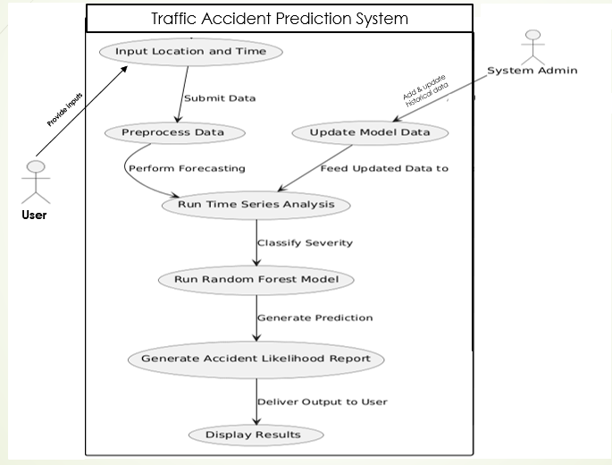
2.3 Use Case Diagram

Slide 8
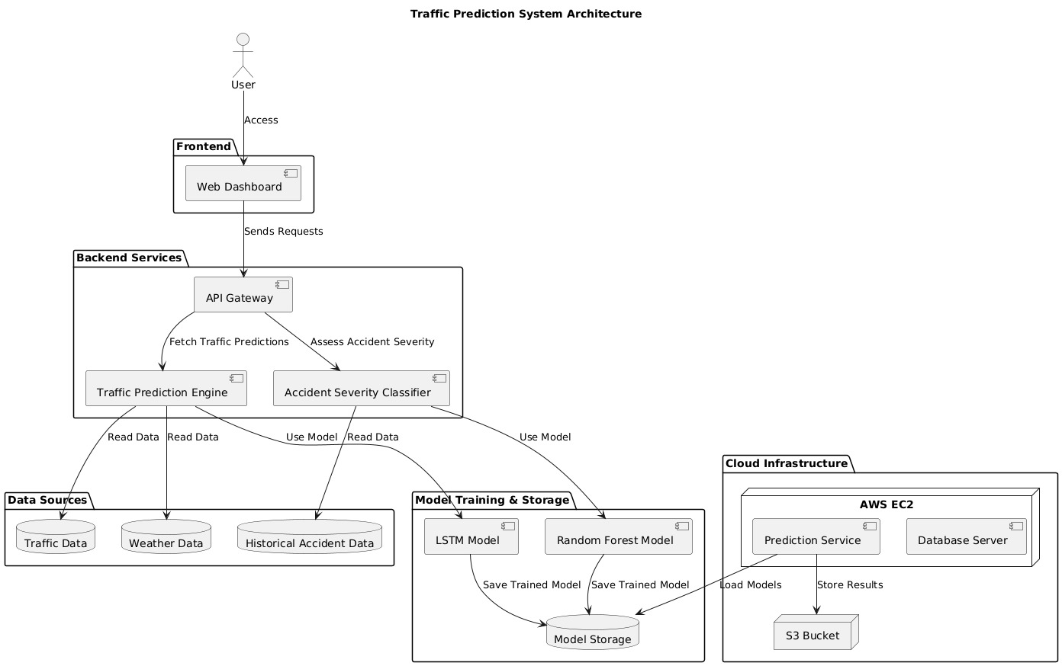
3. Technical Design 3.1 Technical Architecture

Slide 9
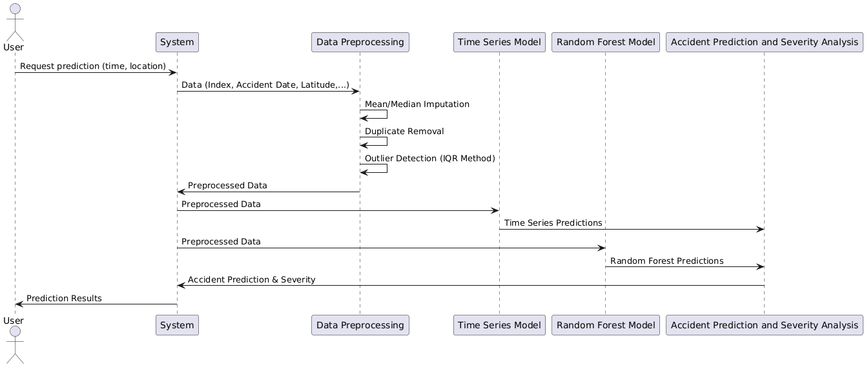
3.2 Sequence Diagram

Slide 10
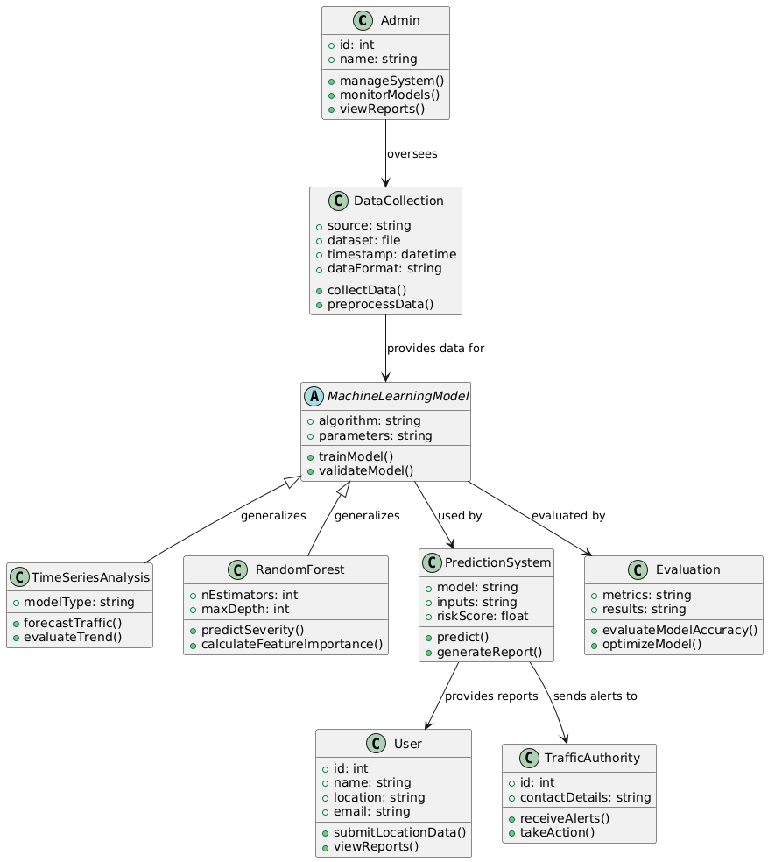
3.3 Class Diagram
reports

Slide 11
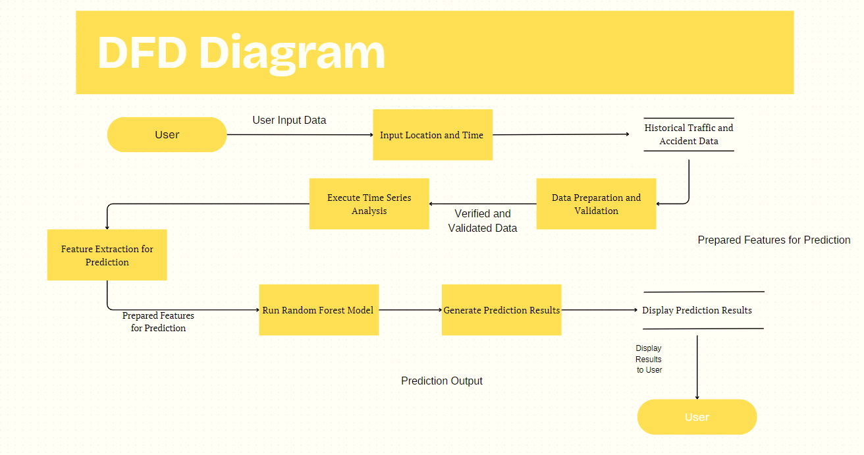
3.4 DFD

Slide 12
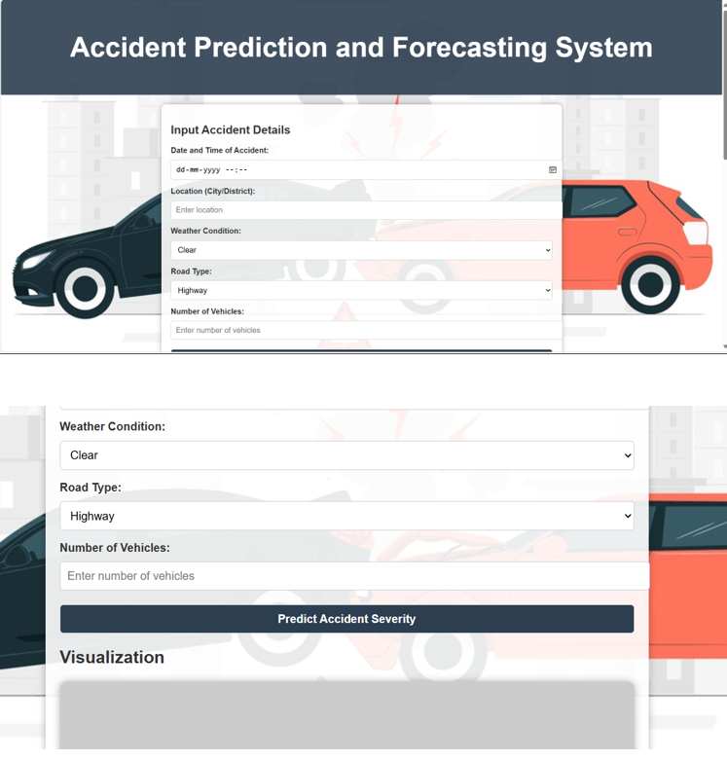
4. User Inface Design

Slide 13
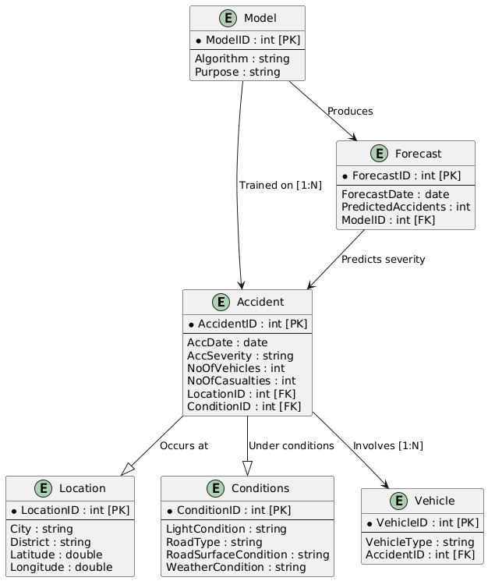
4. Data Design 4.1 Schema design

Slide 14
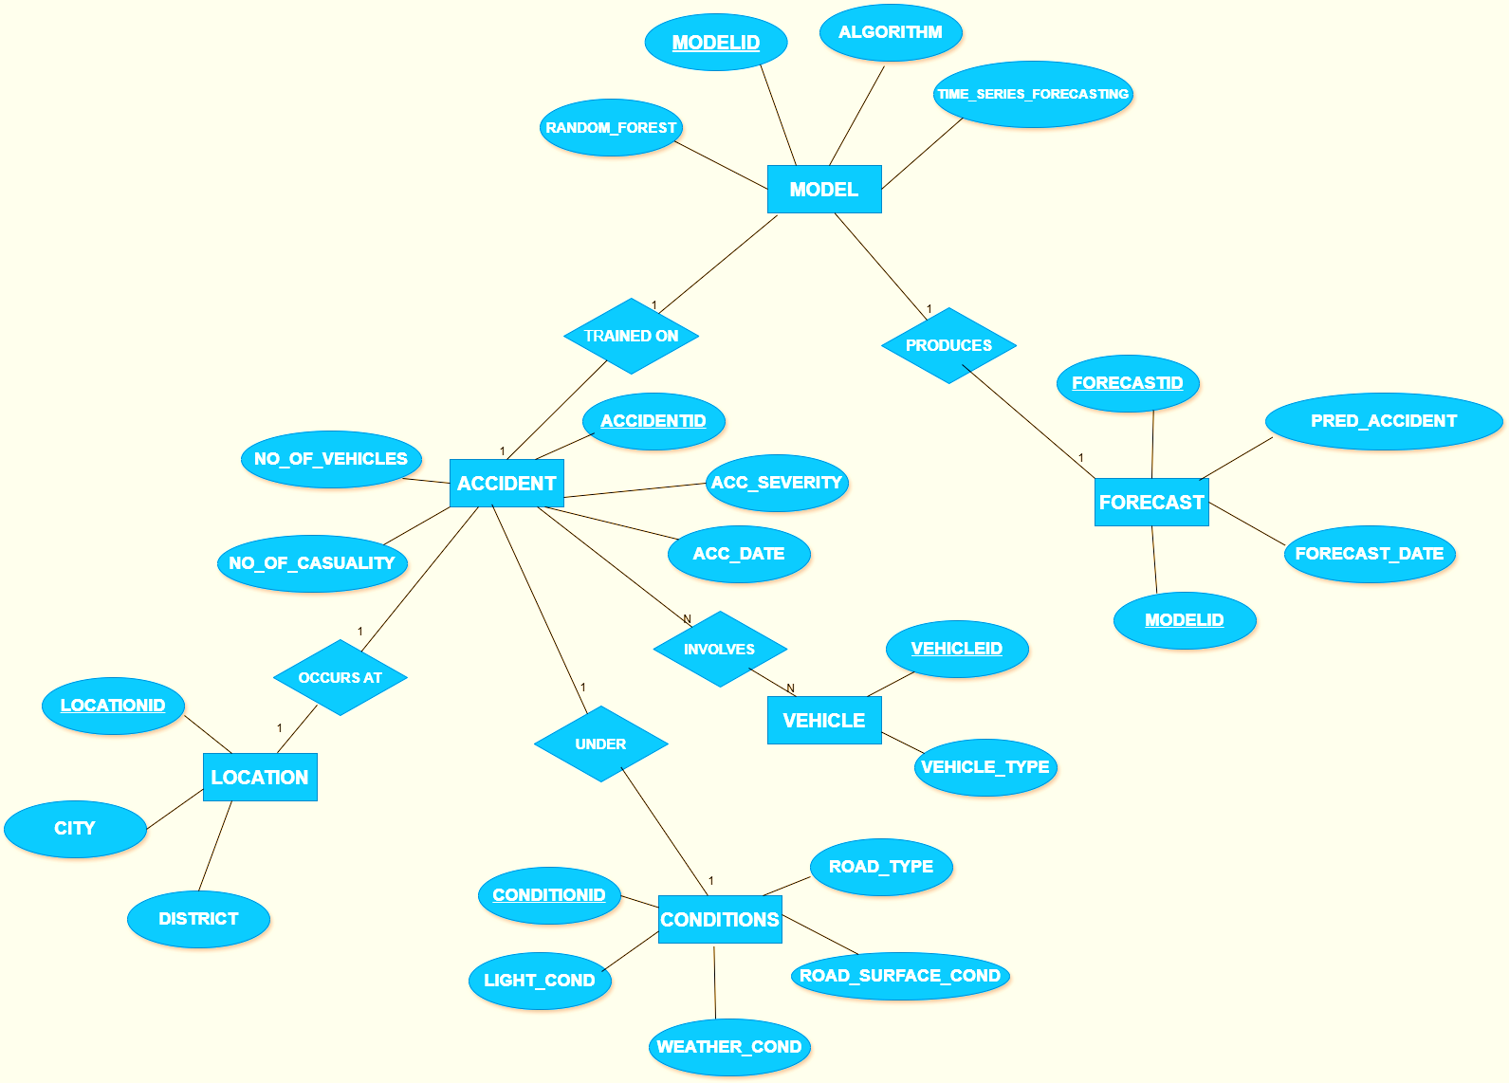
4.2 E-R Diagram

Slide 15
GitHub Link
https://github.com/Ddevanshii10/Proactive-Road-Safety-

Slide 16
REFERENCES
[1] Augustine, T., & Shukla, S. (2022). Road Accident Prediction Using Machine Learning Approaches. International Conference on Advance Computing and Innovative Technologies in Engineering (ICACITE), IEEE, pp. 808–811.
[2] Behboudi, N., Moosavi, S., & Ramnath, R. (2024). Recent Advances in Traffic Accident Analysis and Prediction: A Comprehensive Review of Machine Learning Techniques. A review paper, 26 pages. Subjects: Machine Learning (cs.LG). arXiv:2406.13968 [cs.LG]. Available: https://doi.org/10.48550/arXiv.2406.13968.
[3] Chelule, J. C., Ngetich, M. K., Anapapa, A., & Imboga, H. (2019). Time Series Analysis of Road Accidents Using Autoregressive Integrated Moving Average (ARIMA) Model. International Journal of Science and Research (IJSR), 8(4), 2319-7064. From: www.ijsr.net.
[4] Dr. M. Hemalatha, & Dhuwaraganath, S. (2024). Road Accident Prediction Using Machine Learning. PG & Research Department of Computer Science, Sri Ramakrishna College of Arts and Science, Coimbatore, Tamil Nadu, India, vol 11, Issue 2202, pp. 454-457.
[5] Gupta, D., Goel, V., Gupta, R., Shariq, M., & Singh, R. (2022). Road Accident Predictor Using Machine Learning. International Research Journal of Modernization in Engineering, Technology and Science, vol. 4, May 2022.
[6] Krishna, U. V., Sudhakaran, S., Sanju, S., Vignesh, E., & Kaladevi, R. (2023). Accident Prediction and Analysis Using Machine Learning Models. International Conference on Innovative Data Communication Technologies and Application (ICIDCA), IEEE, pp. 37–40.
[7] Mor, N., Sood, H., & Goyal, T. (2020). Application of Machine Learning Technique for Prediction of Road Accidents in Haryana - A Novel Approach. Journal of Intelligent & Fuzzy Systems, 38(5), 6627–6636.

Slide 17
Thank You
Queries ?

